Slide 1

Interactive Chat System and Statistical Dashboard
By
Rahulji V 22011102073
Saravanakrishnan B 22011102092

Slide 2
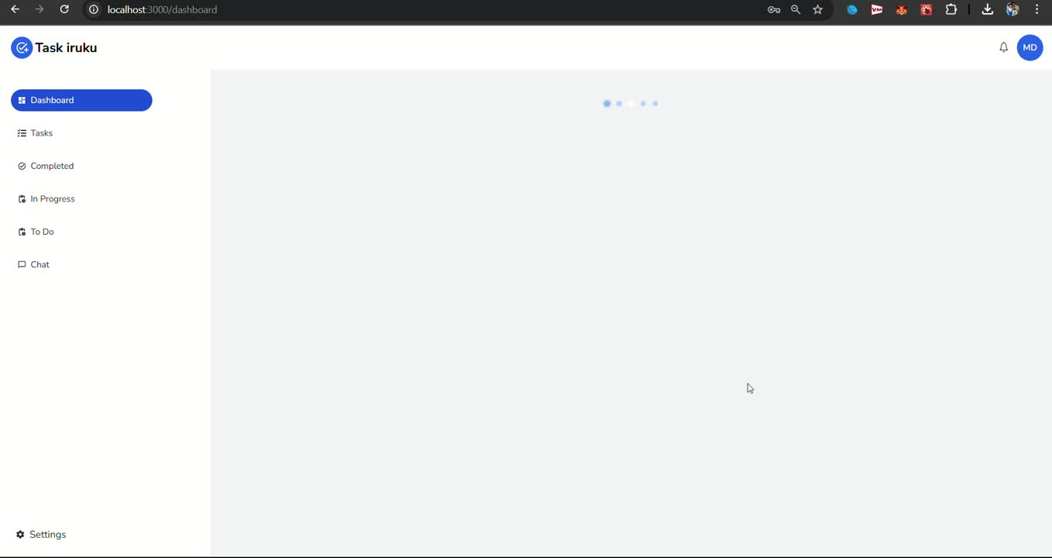
Overview
1
2
3
4
5
6
7
8
9
A overview of our Chatapp and Dashboard User Inteface

Slide 3
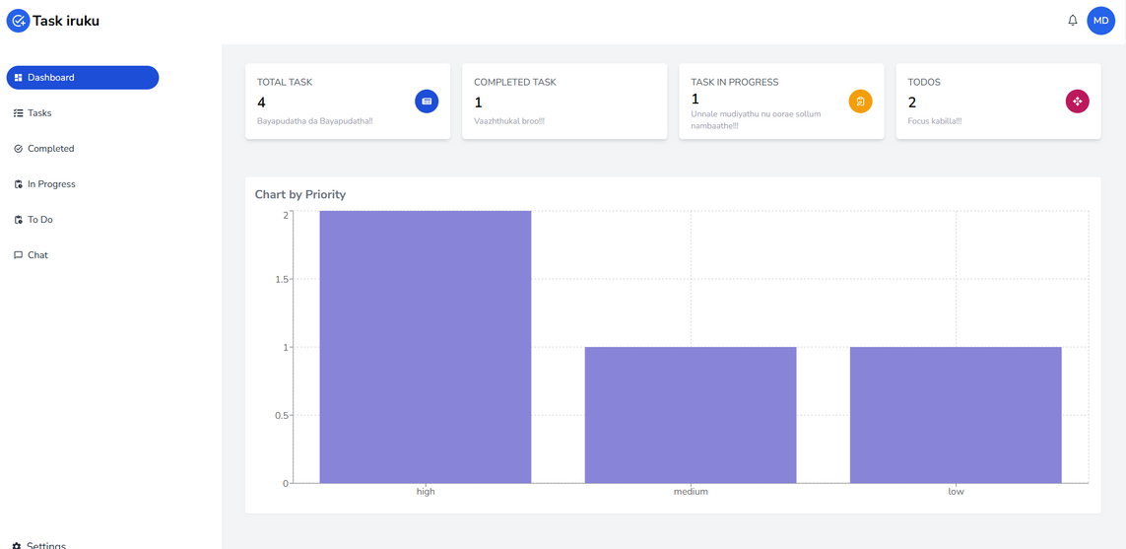
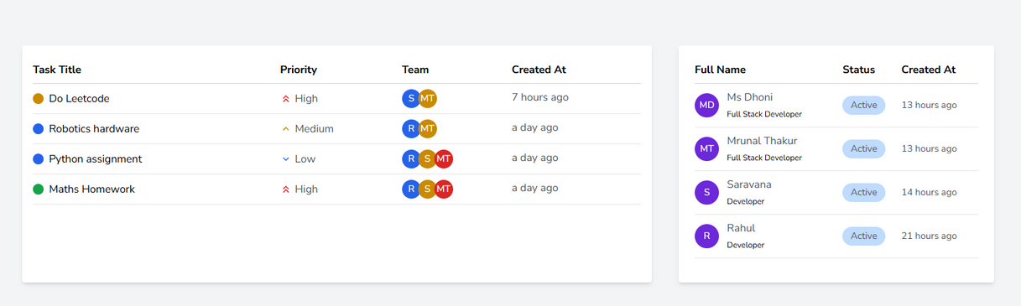
Dashboard Interface
1
2
3
A simple Dashboard Interface to provide the user with upcomming/pending/completed works
providing a list with priority sorting helps the user to asses and execute the most important task first
4
5
6
7
8
9

Slide 4
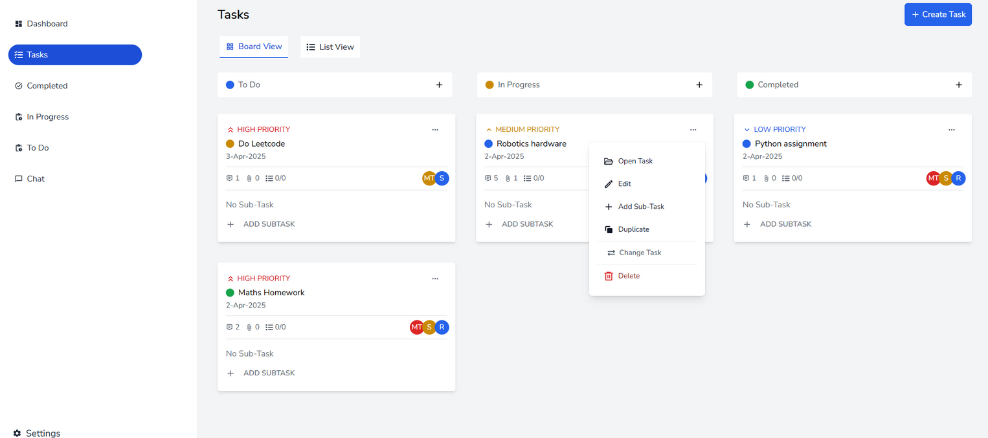
Tasks
1
2
3
4
5
6
7
8
9
A Taskbar to list all the existing tasks for all of the users while mentioning the listed/requested users to complete a certain task A

Slide 5
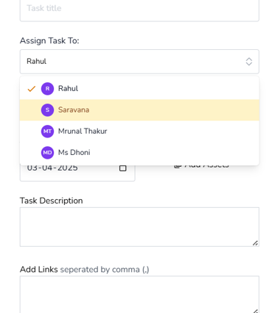
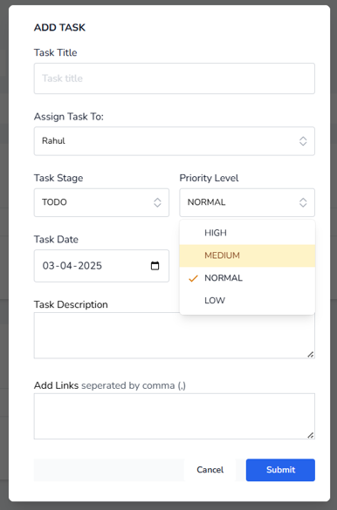
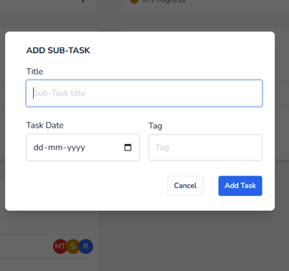
Adding Tasks
1
2
3
4
5
6
7
Tasks can be added and even existing works can have substasks added.
The user can specify task do-ers such as the no of people intended to complete the task and assign materials
8
9

Slide 6
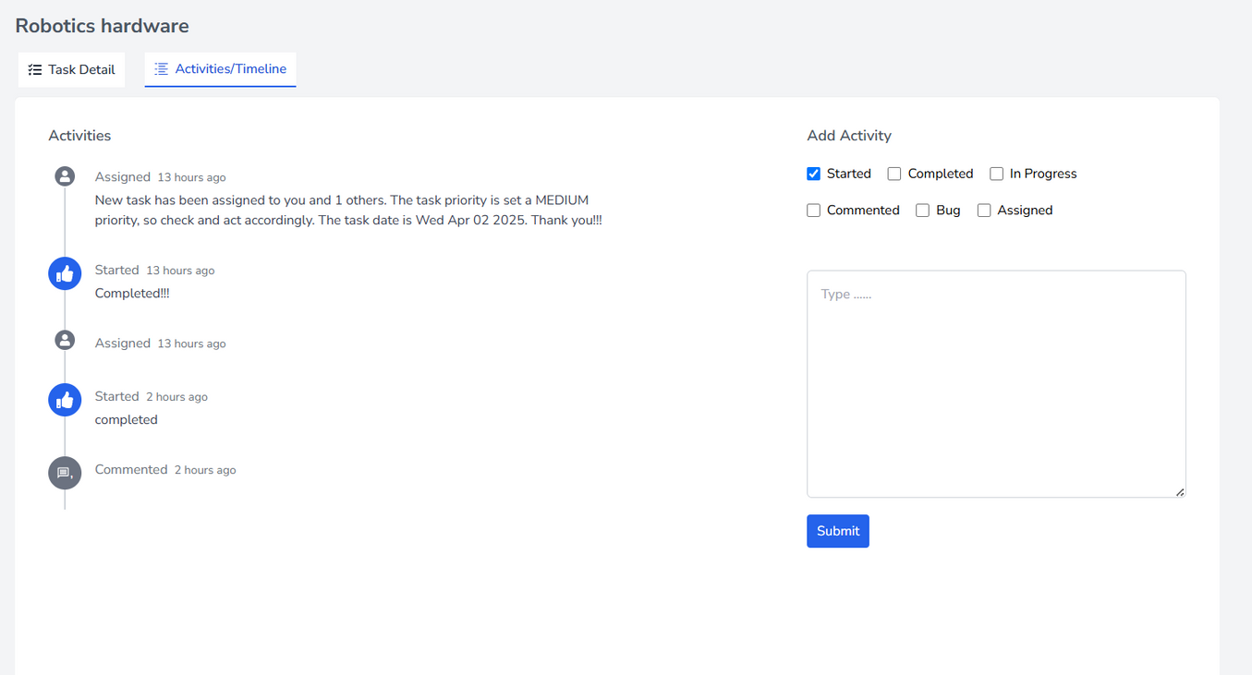
1
2
3
4
5
6
7
8
9
A completed task’s description

Slide 7
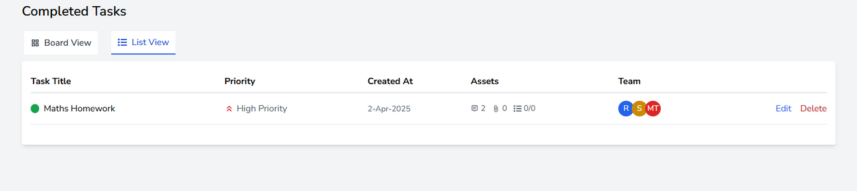
Completed tasks
1
2
Completed tasks are displayed as a list with no of attachments submitted by the assigned users
3
4
5
6
7
8
9

Slide 8
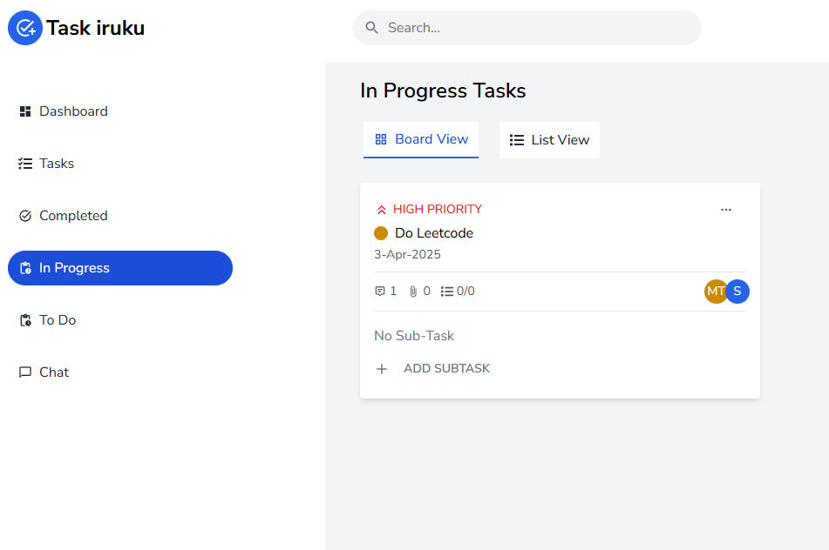
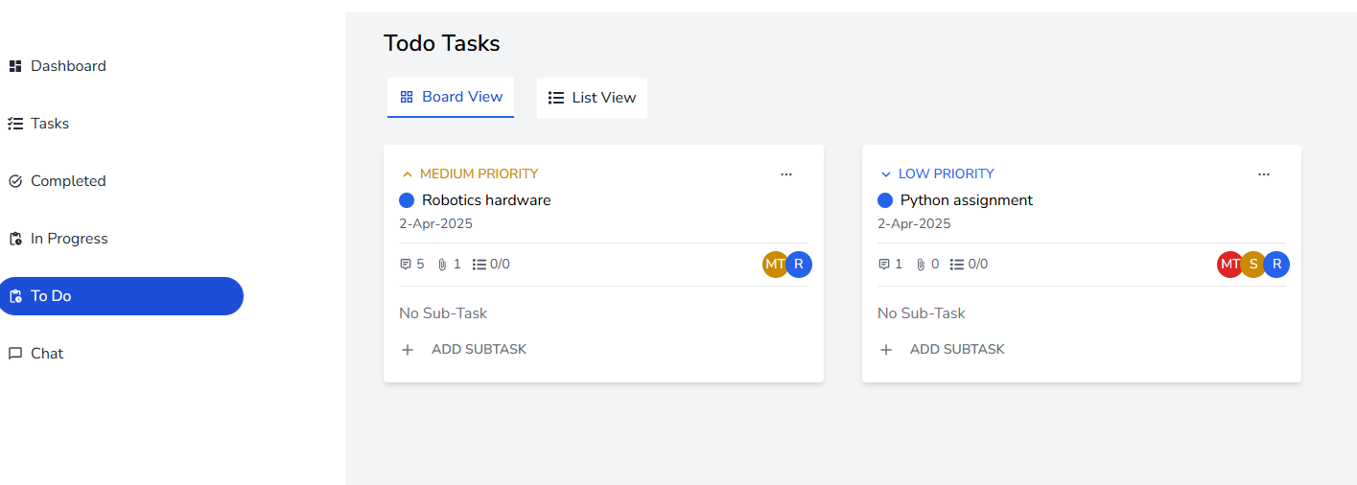
In progress/To do
1
2
A list of Work that is ongoing/yet to do are posted as follows
3
4
5
6
7
8
9

Slide 9
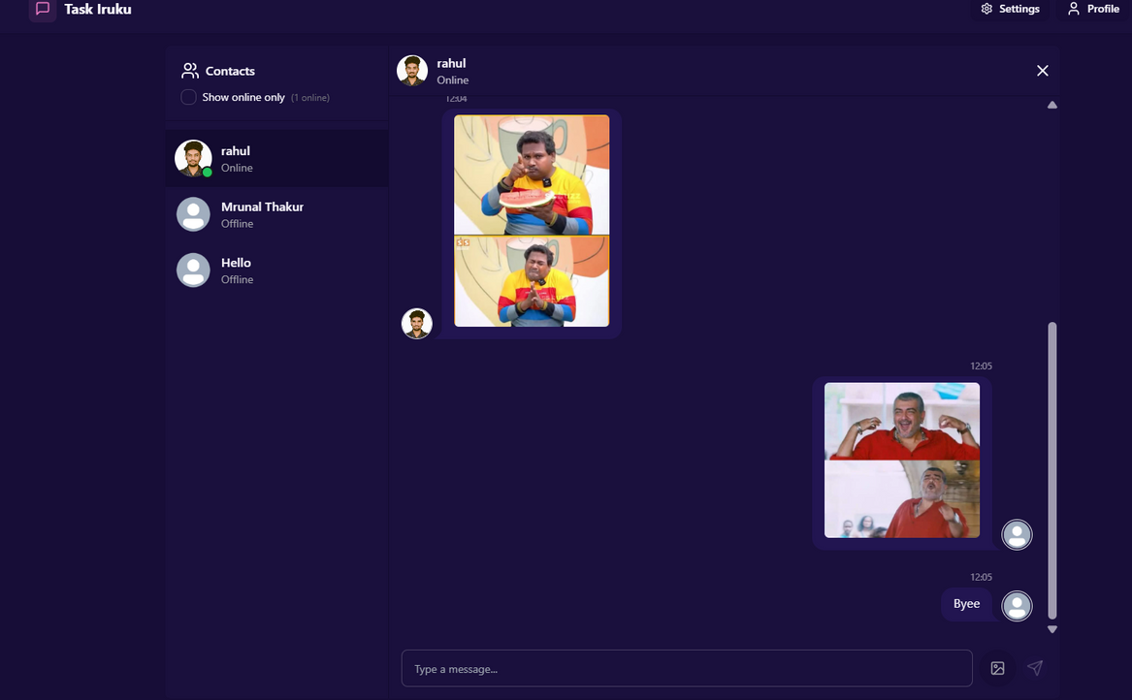
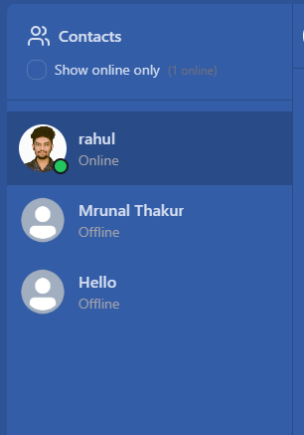
Chatapp
1
2
A interactive chat app that lets the user to text and send images to other users who come in contact with the user and providing info on their status
3
4
5
6
7
8
9

Slide 10
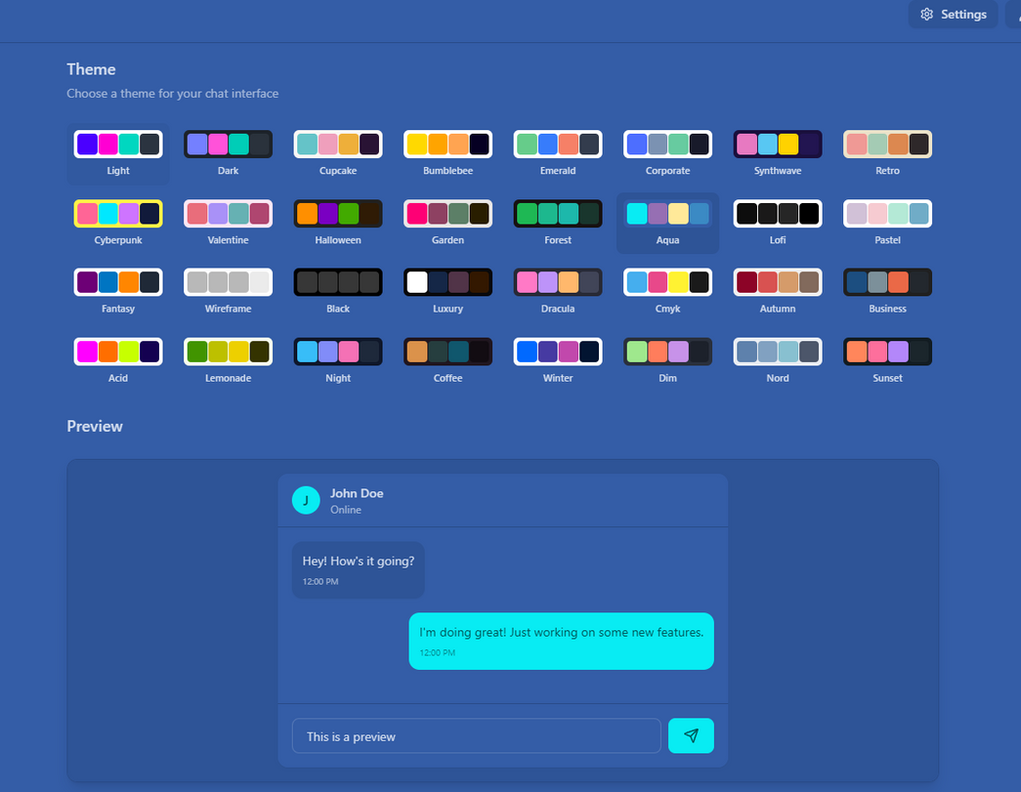
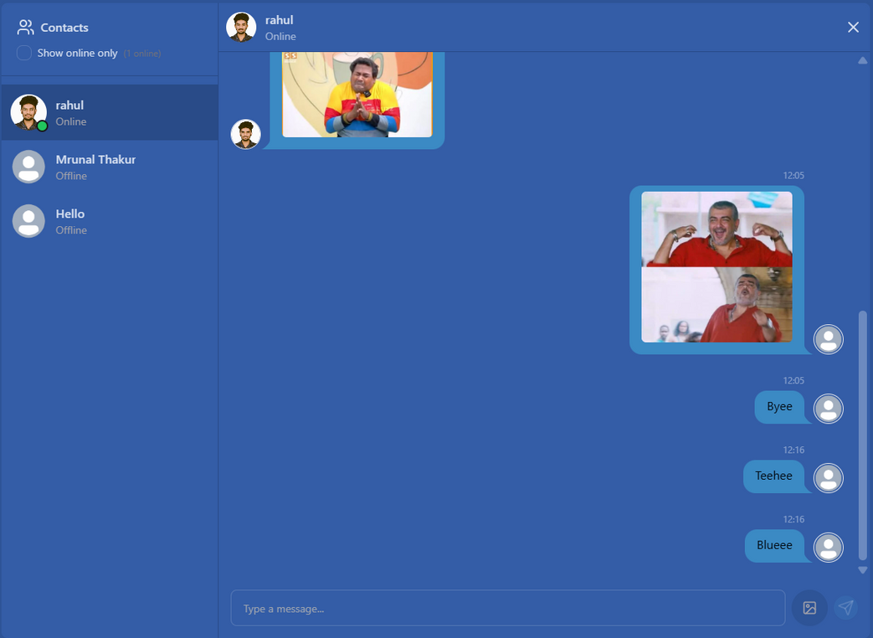
UI Theme change
1
2
3
4
5
6
7
8
9

Slide 11
GitHub Link
https://github.com/RahuljiV2004/Task-manager-with-chat

Slide 12
Thank you :)

